Slide 1

Correlated Predictors
Reading: 3.5
exercises: none
Assigned: hw 7
Producer: dr. mario
img credit: alex riegert-waters

Slide 2
Example: Predicting Price of Home
Question: Using a linear regression model, can we effectively understand why houses from a small midwestern town in 2008 sold for different prices given information about the home size (Size) and the lot size (Lot)?
Question: What do you expect to be the relationship between the predictor variables Size and Lot?

Slide 3
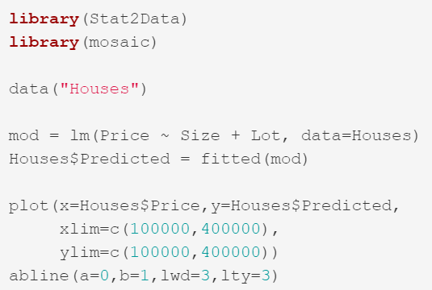
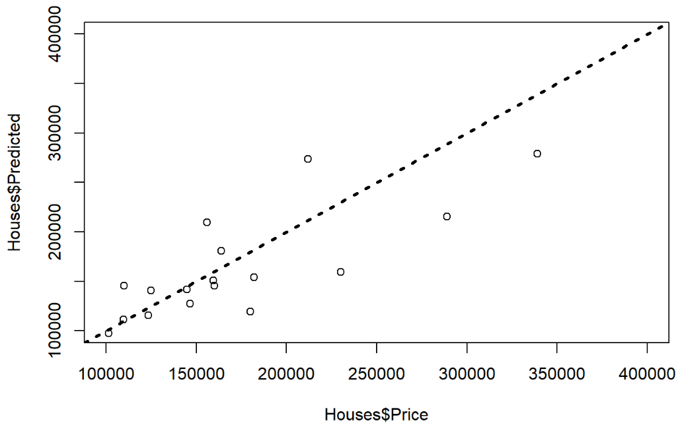

Example: Predicting Price of Home
Line: $y=x$

Slide 4
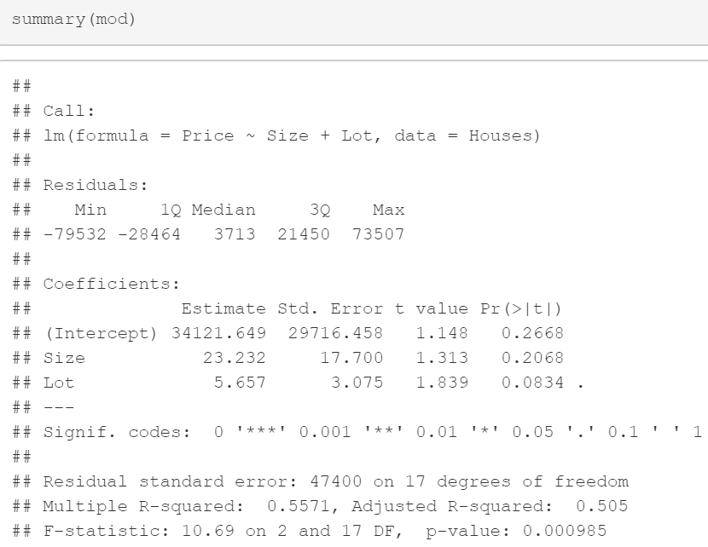
Example: Predicting Price of Home
Are You Surprised?

Slide 5
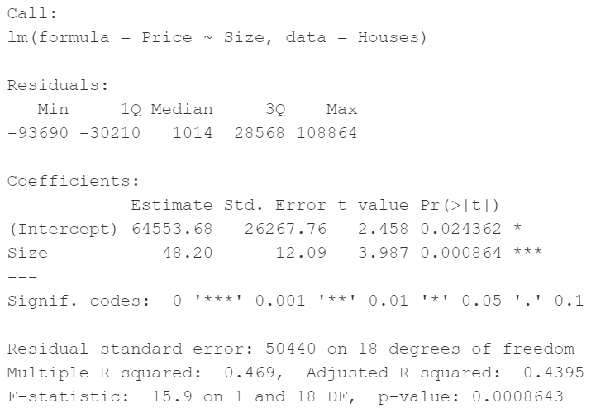
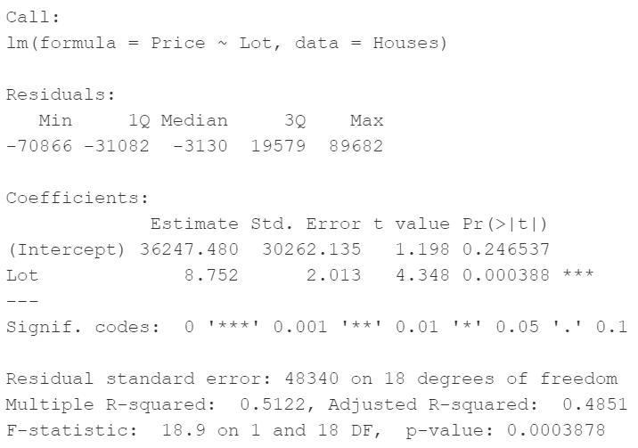
Example: Predicting Price of Home

Slide 6
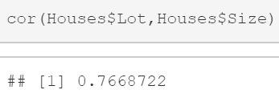
Example: Predicting Price of Home
The Correlation between Lot and Size is relatively high

Slide 7
Multicollinearity
A Set of Predictors Exhibits Multicollinearity when One or More of the Predictors is Strongly Correlated with Some Combination of the Other Predictors in the Set
According to Statology.org, Strong Correlation is Greater than 0.75
This is One Challenge in Dealing with Multiple Predictors
If the One of the Predictors is Perfectly Correlated with Another Predictor, then There is No Unique Solution in Linear Regression

Slide 8
Multicollinearity
The Individual t-Test Assesses How Much a Predictor Contributes to the Model After Accounting for the Other Predictors
When Two Predictor Variables are Individually Important but Highly Correlated, They Both Don’t Need to be in the Model Together
If They are Both Included, R-Squared will be Moderately Improved and Adjusted R-Squared could Possibly Get Worse

Slide 9
Detecting Multicollinearity
Correlation Matrix: Calculates the Correlation Between Every Pair of Predictor Variables
Scatterplots: Create a Scatterplot for Every Pair of Predictor Variables
We Wouldn’t Know if We had a Predictor that Was Highly Associated with a Combination of Predictors
Example:
$$\hat{Grade}=β_{0}+β_{1}\left(Grade on M1\right)+β_{2}\left(Grade on M2\right)+β_{3}\left(Average M Grade\right)+ε$$

Slide 10

Detecting Multicollinearity
Fit Linear Regressions Where Each Predictor Acts as a Response Variable
Estimate R-Squared for Each of These Linear Regressions
Variance Inflation Factor:
Rule of Thumb: Bad VIF is Greater Than 5 (R-Squared > 0.8)
$$VIF_{i}=\frac{1}{1−R_{i}^{2}}$$

Slide 11
Handling Multicollinearity
Option 1: Drop Some Predictors
Check to See if R-Squared Drops Drastically
Examine Effect on Residuals and Model Assumptions
Option 2: Combine Some of the Predictors
Average or Sum of Groups of Predictors (Example: Survey)
Option 3: Interpret Coefficients and t-Tests with Caution
Option 4: Use Stepwise Algorithms (4.2) or Cross-Validation (4.3)

Slide 12
Thank You
Make Reasonable Decisions

